Slide 1
Young People, the faith and vocational discernment
XV Ordinary General Assembly of the Synod of Bishops
October 2018

Slide 2
Synod prayer
Lord Jesus in journeying towards the Synod, your Church turns her attention to all the young people of the world.
We pray that they might boldly take charge of their lives, aim for the most beautiful and profound things of life and always keep their hearts unencumbered.

Slide 3
Accompanied by wise and generous guides, help them respond to the call you make to each of them, to realize a proper plan of life and achieve happiness. Keep their hearts open to dreaming great dreams and make them concerned for the good of others.
Like the Beloved Disciple, may they stand at the foot of the Cross, to receive your Mother as a gift from you. May they be witnesses to your Resurrection and be aware that you are at their side as they joyously proclaim you as Lord.
Amen.

Slide 4
THE SYNOD AND WHAT IT DOES
PART ONE

Slide 5
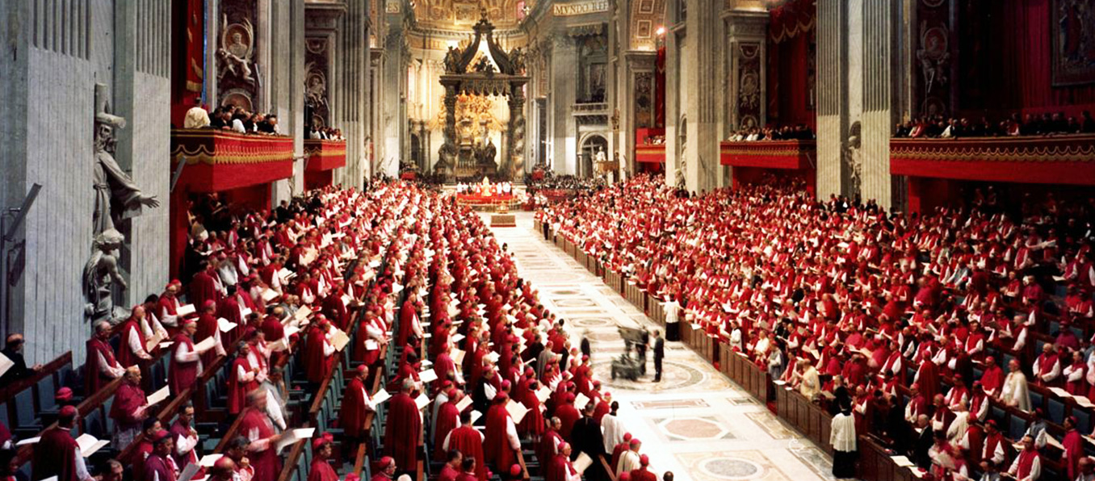
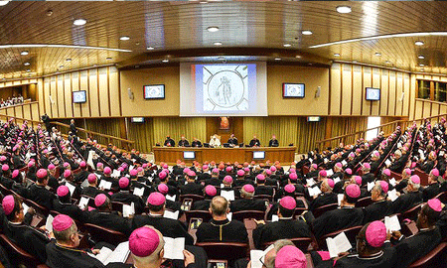
The synod is a group, not an event
Second Vatican Council (1962-1965)
Synod of Bishops
Notes:
On 15 September 1965, as the Council was drawing to a close, Pope Paul VI took matters into his own hands and set up the Synod of Bishops,^{[10]} noting that "the Ecumenical Council … gave Us the idea of permanently establishing a special Council of bishops, with the aim of providing for a continuance after the Council of the great abundance of benefits that We have been so happy to see flow to the Christian people during the time of the Council as a result of Our close collaboration with the bishops."
Can. 342 The synod of bishops is a group of bishops who have been chosen from different regions of the world and meet together at fixed times to foster closer unity between the Roman Pontiff and bishops, to assist the Roman Pontiff with their counsel in the preservation and growth of faith and morals and in the observance and strengthening of ecclesiastical discipline, and to consider questions pertaining to the activity of the Church in the world.
Synods, of course, are an ancient idea, not a new initiative of Vatican II, but rather a revival.

Slide 6
Like most groups, it meets every now and then
Ordinary General Assemblies (planned meetings – roughly every three or four years)
Extraordinary General Assemblies (called to discuss urgent matters. There have been three since 1965)
Special Assemblies (Called to discuss regional matters, and involving only people from that region)
Notes:
We're not going to talk about the last two because that's not what's happening next year. Rather, next year is an Ordinary General Assembly, and so it's worth thinking briefly about what that is exactly...
There can be things like local synods too e.g. within Dioceses

Slide 7
ORDINARY General assemblies
Instrumentum Laboris
(working document, based on responses to consultation)
Apostolic Exhortation
(Concluding document)
Assembly
Notes:
Mention that a Preparatory document and/ or a Lineamenta come before the Instrumentum Laboris.
Historically, the apostolic exhortation has a loose relationship with input.

Slide 8
SOME EXAMPLES
YEAR TOPIC APOSTOLIC EXHORTATION
1974 Evangelisation on the Modern World Evangelii Nuntiandi
1977 Catechesis in Our Time Catechesi Tradendae
1987 The Vocation & Mission of the Laity Christifideles Laici
2012 The New Evangelisation Evangelii Gaudium (Pope Francis)
2015 The Vocation & Mission of the Family Amoris Laetitia
Notes:
Just because there was a big splash around Amoris, don’t think this one will be as big…

Slide 9
KEEPING IT SIMPLE
The Synod of Bishops is a group that advises the Pope.
It meets every few years to discuss important topics.
Afterwards the Pope issues a teaching document.

Slide 10
THE XV General assembly, and where it’s coming from
PART TWO

Slide 11
It was announced in October 2016 that the XV General Assembly of the Synod of Bishops would focus on
Young People, the Faith and Vocational Discernment
To be held in October 2018.

Slide 12
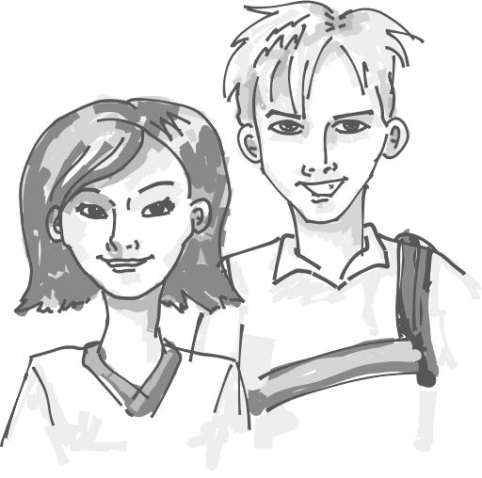
It flows from “the joy of the gospel”
2015 (& 2014) Assemblies on the Family.
(Amoris Laetitia)
..in the family
2018 Assembly on YOUTH!!
Notes:
Mention Aparecida (briefly)

Slide 13
So, what’s up for discussion..?
So far, the Preparatory Document (January 2018) and the Working Document (July 2018) have been issued. It is in three parts, and that may give us an early hint.
The social & cultural dynamics of the world in which young people live.
The fundamental steps of the process of discernment.
Key points in a pastoral vocational program for youth.
In other words:
What the modern world is like for young people
What it’s like growing up and making fundamental choices in that world
How the Church can help

Slide 14
What Happens Next..?
PART THREE

Slide 15
OCTOBER 2018 – THE ACTUAL ASSEMBLY
Lasting around 15-20 days. Young People and Youth Ministers likely to be invited, as well as Bishops.
EARLY 2019 – APOSTOLIC EXHORTATION
Perhaps the modern first papal document (at least at this level) on young people and youth ministry

Slide 16
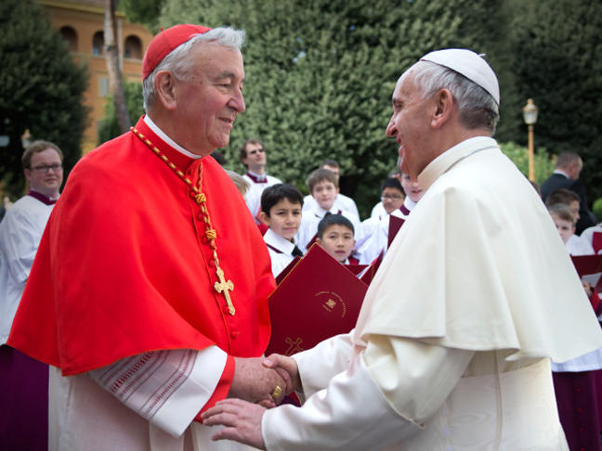
How is a synod run?
Cardinal Nichols, along with other Cardinals and Pope Francis form the Synod Council who will listen to everyone speak
Each Bishop has 3 minutes to either give a statement or ask a question
Experts also have the opportunity to speak
After each section has been covered a report is written on the conversations and is released.

Slide 17
Young People, the faith and vocational discernment
Any thoughts? Any questions?

Slide 18
Mock synod

Slide 19
Closing prayer
Lord Jesus, we give thanks for this time together, for our thoughts and conversations. We pray especially for Pope Francis and Bishop Declan that they will continue to lead in our Mission as young disciples, in our Communion with Christ and in our Prayer.

Slide 20
We remember all young people in our diocese of Clifton and across the entire world. May we all feel peace and joy that in our lives, and hear your call to ‘Go out to the whole world; proclaim the Good news to all creation.’
Amen.

Slide 21
Mock synod

Slide 22
Young People, the faith and vocational discernment
XV Ordinary General Assembly of the Synod of Bishops
October 2018

