Slide 1
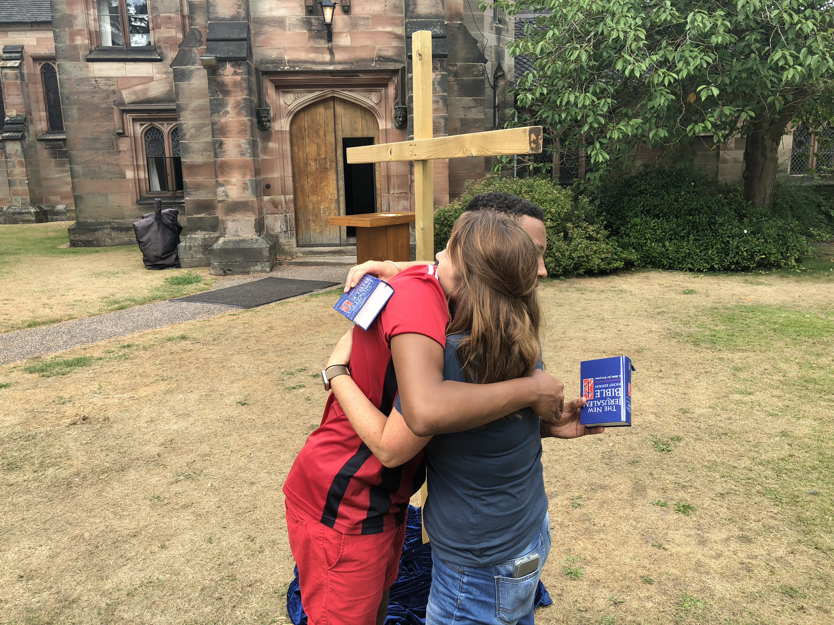
Religious Identity of Catholic Teenagers
Avril Baigent
avril.c.baigent@durham.ac.uk
Notes:
Introduce myself
Would like this to be a conversation – put questions in the chat, and also I’ll stop and take questions at appropriate moments along the way. There will be time for conversation at the end.

Slide 2
Four stereotypes of young Catholics
1. Not proper Catholics – lacking or absent
2. Anomalous – what young person would want to be a Catholic?
3. Changing the Church – battling the institution
4. The future of the Church
Notes:
put in chat which of these resonates with you

Slide 3
Church teaching developing
12. Young persons exert very important influence in modern society. There has been a radical change in the circumstances of their lives, their mental attitudes, and their relationships with their own families. Frequently they move too quickly into a new social and economic status. While their social and even their political importance is growing from day to day, they seem to be unable to cope adequately with their new responsibilities.
…They should become the first to carry on the apostolate directly to other young persons, concentrating their apostolic efforts within their own circle, according to the needs of the social environment in which they live.
Apostolicam Actuositatem (1965)

Slide 4
299 Dear young people, my joyful hope is to see you keep running the race before you, outstripping all those who are slow or fearful…May the Holy Spirit urge you on as you run this race. The Church needs your momentum, your intuitions, your faith. We need them! And when you arrive where we have not yet reached, have the patience to wait for us”.
Christus Vivat (2019)
Notes:
DON'T FORGET DAVID AND GOLIATH - PROPHETIC ROLE OF YOUNG PEOPLE IN BIBLE AND CHURCH HISTORY!

Slide 5
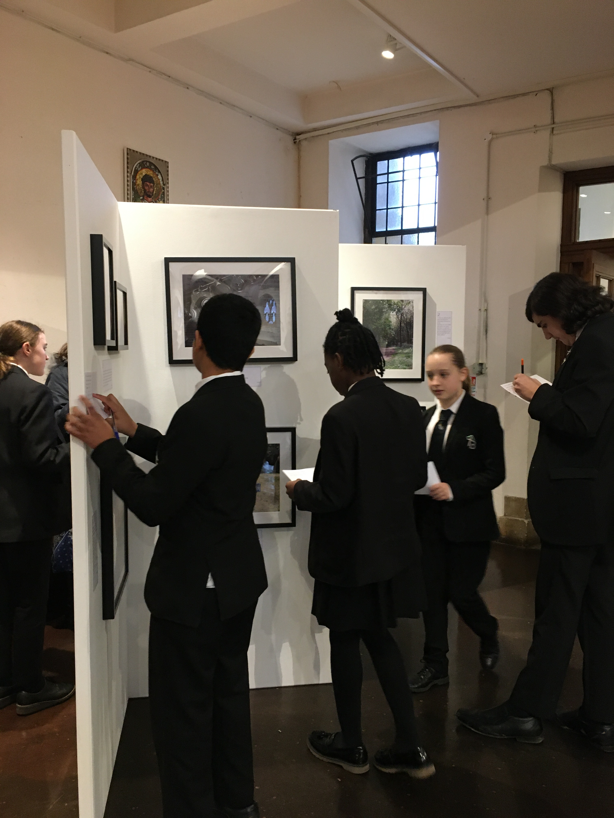
Research Method - adapted
Ask the question of a group: what do you think of when you hear the word Catholic?
Follow up questions: where does being Catholic come from for you? Does being Catholic make a difference in your life? Do you think you’ll stay Catholic into the future?
Ask the group to take photos on the theme: “This is Catholic”
Group can share the photos and talk about why they took them
Exhibit in the parish/school

Slide 6
Obstacles to overcome
Emma: there were some girls at the back of the classroom who found it really funny and who were like joking about it, and one of them was like, I’m a Christian, I go to church every week, I do this, I do that, but like she wasn’t, she was like mocking it all, and I was sitting at the front of the classroom listening to it and everyone was laughing because they thought it was hilarious and I was just a bit like, like, I didn’t know what to think about it. It’s just awkward.⁠
Pete: They used to do like a sort of prayer thing in the chapel at school. And people go, but they wouldn’t be all like, big practising Catholics. Just sort of went, and they would just sort of laugh. So I just stopped going. Didn’t feel like a safe place. Felt threatened so…⁠

Slide 7
Family identity
Lena: From being brought up Catholic because my parents like instilled it upon me, because I’ve always gone to church, even when I was little, so it’s just like carried on until now. If I didn’t have that guidance, from say parents and family, then I probably wouldn’t be Catholic, because it wouldn’t have occurred to me.⁠
Marzena: And another thing is that my parents, even though I say that they pressured me into it, I’m actually glad they actually showed me the ways, although some of their methods aren’t, I’m not too keen on! <laughs> I mean, they did their best and it’s because they’re holding up the promise you do when you have your child baptised, when you want to keep them growing up in church, so I understand everything is from good will and yeah⁠
Immie: I think [being Catholic] does contribute to make me who I am, because I don’t know what it would be like without it, because I’ve grown up with my dad being quite religious. It’s sort of, I’ve picked it up as well. I don’t know what I’d be like without it, so… I think it does contribute to my life a lot.⁠

Slide 8
Catholic Teaching
Marianna: There are just some things in the Bible that I don’t agree with, like, erm, attitudes towards, erm, females in the Bible,[…] and there’s like the modern issues of sexuality as well and… people’s like, identity, that I sometimes find unnecessary.
I: Hmm. Does that make you, not want to be a Catholic or does it…?
M: No, it just… Because some people will categorise all Catholics into believing the same thing, but people will interpret the Bible differently, I just have a different interpretation to other, more conservative people.⁠

Slide 9
Personal relationship with God
Pete: To be Catholic…is to believe in God. Cos God is always there, he loves you, even if you don’t think he does, you’ve just got to have it in your mind. If you can tell that God doesn’t loves you, he does, but it’s your mindset rather than God’s, I think. It’s more of a personal thing.⁠

Slide 10
Significant but low-key identity:
Leon: I’ll say “I ALWAYS have it on” <laughs> Um, it’s the best, you know, reminder, like even when I’m not thinking about it, it’s there, which is quite sort of mirrors my faith in a sense… as in you’re not always thinking about “Oh I wonder what God would think about that” <laughter> you know, you live your life and then, you think about it once in a while

Slide 11
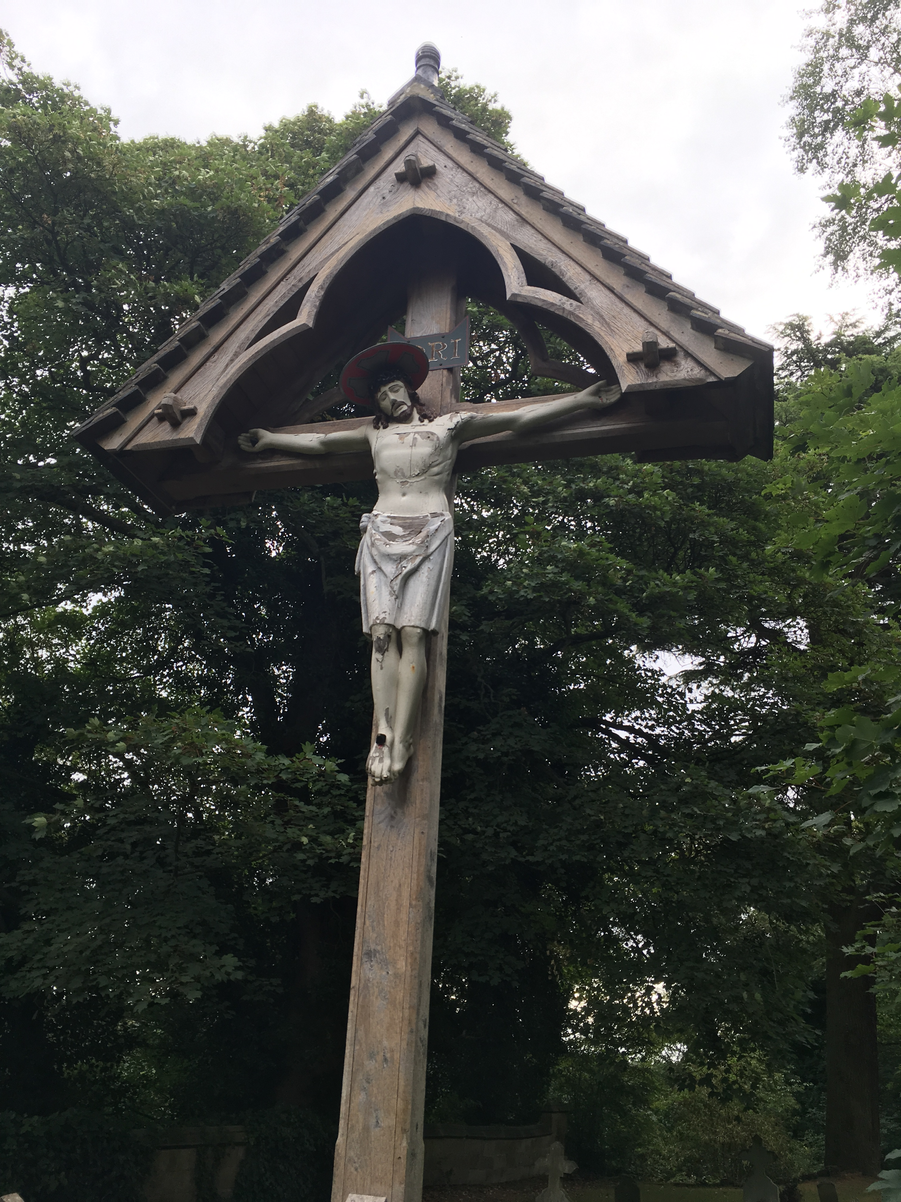
Importance of family, peers, community (parish and school communities)
Actively engaged – but their own way of being Catholic, eg praying every day and not going to Mass, or going to Mass every week and not praying
Tom: Hmm… The crucifix in the graveyard over there. What I thought it was, it’s what happens to our faith when we don’t keep up with, keep up with that? Keep praying, keeping it strong, it starts getting a bit tattered?⁠

Slide 12
Significant gaps
Little devotion to the Eucharist – communion as community
About half not bothered about weekly Mass going – stricter families
Personal relationship with God ≠ active discipleship

Slide 13
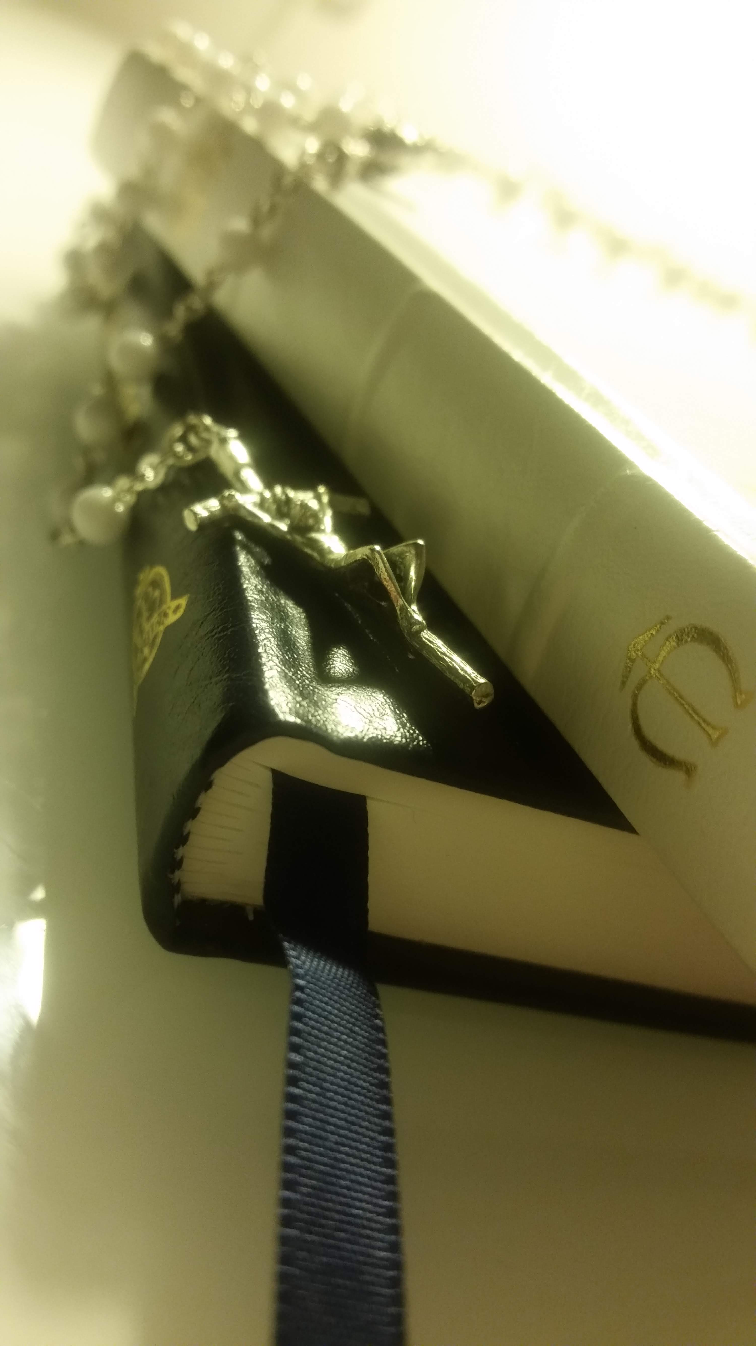
Spiritual apprenticeship/ Accompaniment
https://millionminutes.org/accompaniment-resources-1
Intentionally forming young people for lives as Catholics – what are our sacramental programmes/school chaplaincy/youth outreach for?
Where is our hope? Let’s talk about our faith openly
What is our toolkit for difficult times?
How as Catholics are we distinctive, and what is our offer to the world? Spiritual treasures – examen, lectio divina

Slide 14
Moments of Choice
Lena: Communion is more forced by your parents <laughs> I’d say but I feel like the sacrament of confirmation is your own decision and I took that decision and I’m happy.
Marianna: I think from when you start having your confirmation and you’re making those decisions for yourself and it becomes in your own hands rather than your grandparents telling you what to do and there’s opportunities when they won’t be there and I can chose, do I go to church or not, and I always chose to go because it’s what I believe in.⁠

Slide 15
Peers– practising young Catholics need other practising young Catholics
Where do they meet? School/parish groups/diocesan events/World Youth Day (WYD at home)
I: And what about you, Red, groups and things? Is there anything at Our Lady’s that you go to?
Red: The only time I went to something was Lux:Be [diocesan winter youth retreat]
I: Ok…. And what was that like.
R: It was actually pretty good. Like, I could have talked to a lot of people about their religion, their history of other religion, and how much they go to church and pray every day. I talked to a lot of people at Lux:Be and it was compared <?>, like, there was one person who prayed like really a lot like every day, and there was one person who prayed like, barely…. You could know other things that you didn’t know before. <thinking> Excepting parents, there was somebody, actually adults, you could talk about faith, just like there’s really barely anyone at school who’s like Christians really.⁠

Slide 16
Parish Engagement
Don’t be afraid to be Catholic – that’s why they are coming Importance of prayer – adoration/lectio
Build relationships
Have food
Music group/film group/servers/youth alpha/Sycamore (older teens)/social justice SVP, Million Minutes prepare the future resource https://millionminutes.org/future
Seasonal – eg decorate the church
Intellectual engagement – older ones. Word on fire? https://www.wordonfire.org/videos/
For planning – MM Courtyard process https://millionminutes.org/courtyard-resources-1
Be prepared to answer questions!

Slide 17
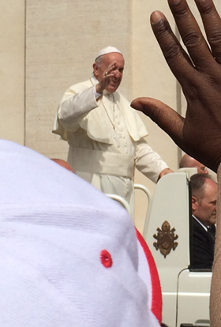
Parishes as places of community
How hospitable are we? What is our attitude to young people?
Significant individuals – priests, adults
Accompaniment
We can all smile, ask after and treasure the young people in our midst
Young people and leadership opportunities – D of E! children’s liturgy, MCing, leading youth group, music group, stations of the cross, Christmas/Advent Mass, sacristan, readers and Eucharistic Ministers

Slide 18
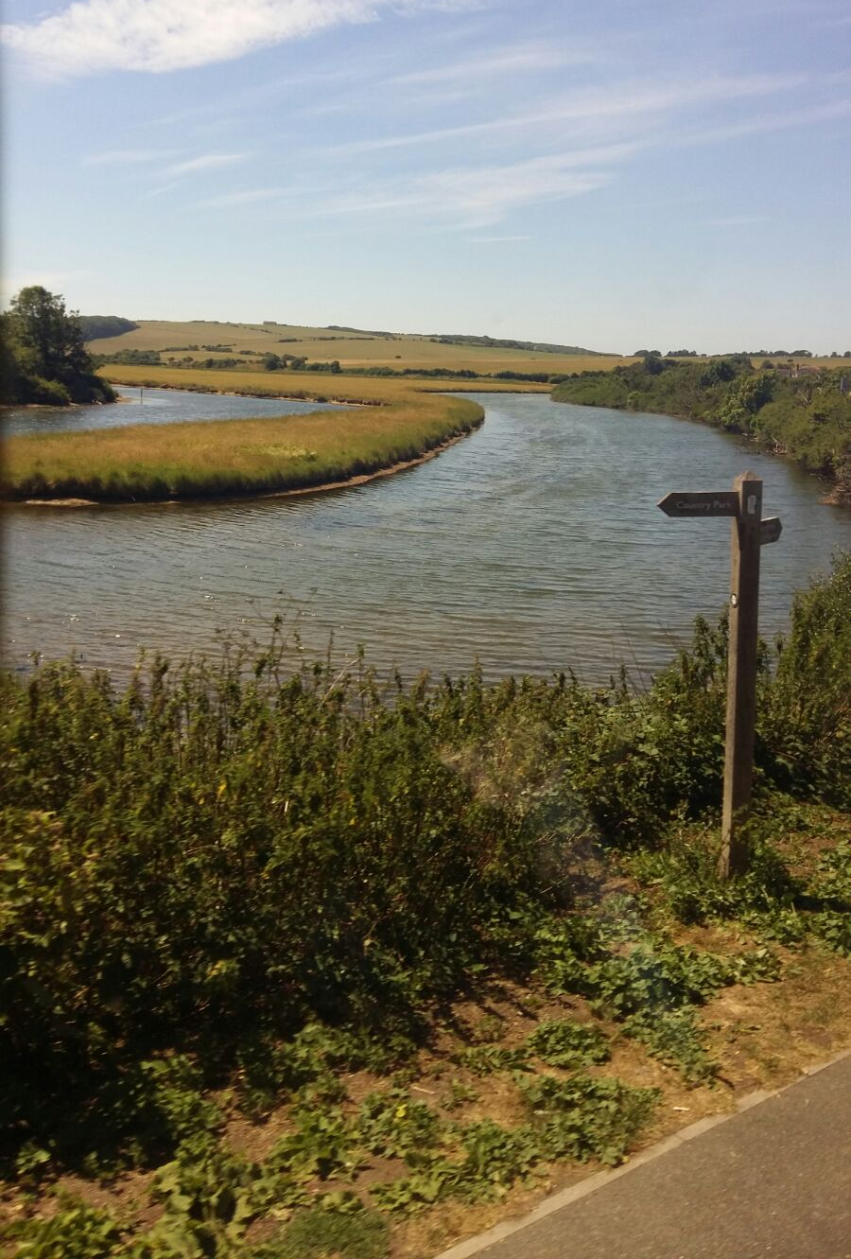
Active Involvement
Agency – back to David and Goliath
The young people in my study wanted to be Catholic and worked hard at it – this is good news!
It’s good for young people to be Catholic – this is also good news!

Slide 19
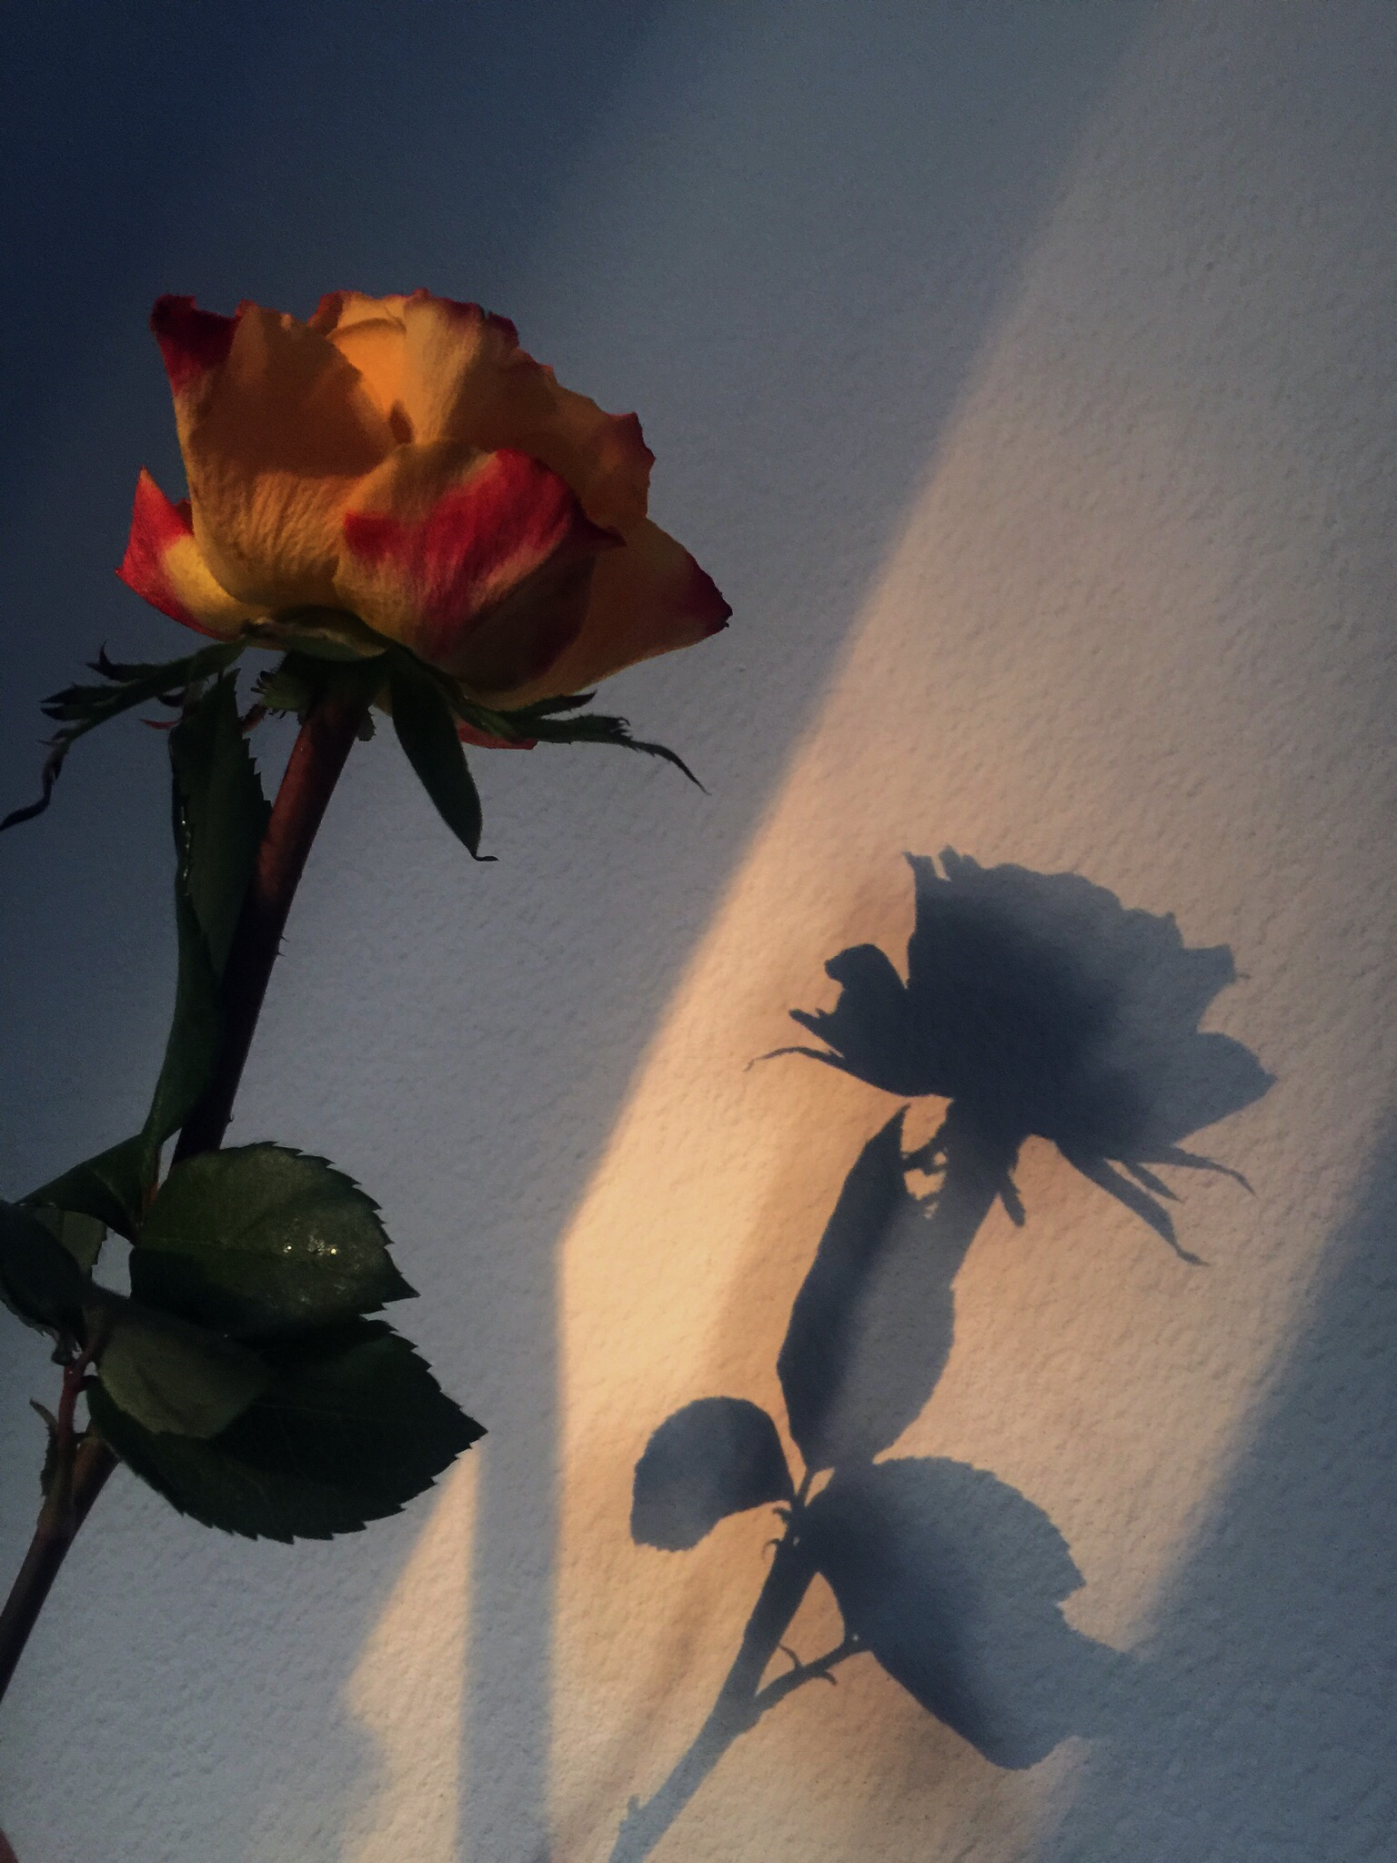
299 Dear young people, my joyful hope is to see you keep running the race before you, outstripping all those who are slow or fearful…May the Holy Spirit urge you on as you run this race. The Church needs your momentum, your intuitions, your faith. We need them! And when you arrive where we have not yet reached, have the patience to wait for us”.
Christus Vivat

